Slide 1
FACE RECOGNITION A specific case of object-class detection

Slide 2
Applications
1. Facial motion capture 2.Facial recognition – biometric, attendance 3.Photography - autofocus
4.Image Search 5.Marketing

Slide 3
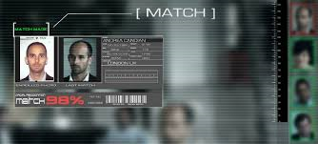
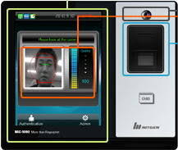

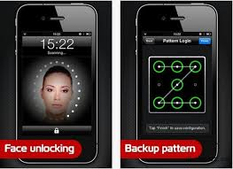
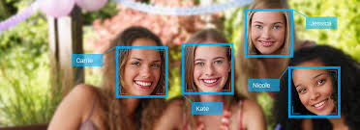

Slide 4
Getting Started
Machine Learning
Convolutional Neural Networks
Alexnet
Matlab
Laptop and a webcam

Slide 5
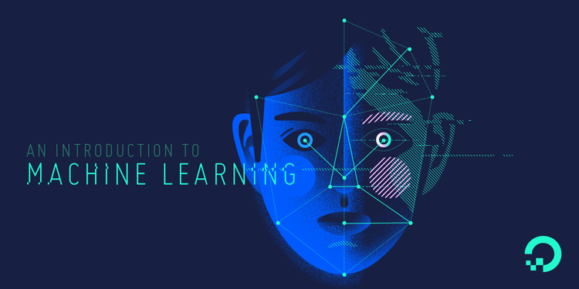

Slide 6
Understand the structure of data and fit that data into models that can be understood and utilized by people.
Machine learning brings together computer science and statistics to harness that predictive power.
Supervised Learning
Unsupervised Learning

Slide 7
Common Supervised Algorithms
KNN – K nearest neighbor algorithm
SVM – State Vector machine

Slide 8


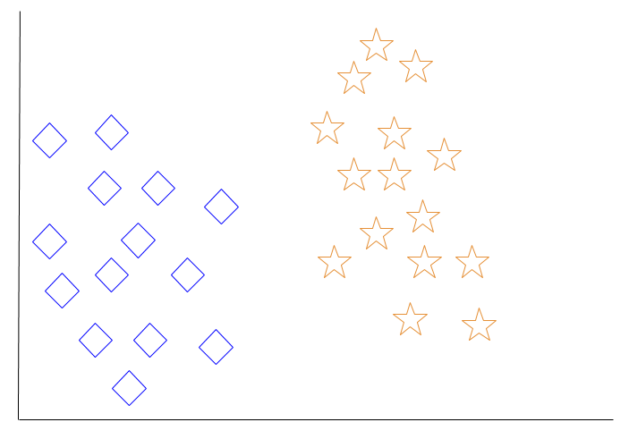
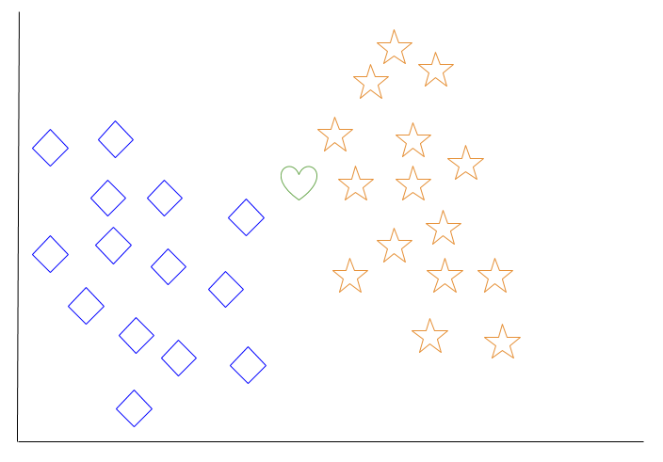
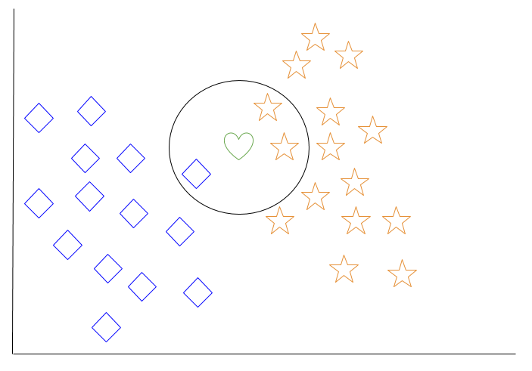

KNN - K nearest neighbor algorithm
z
z

Slide 9
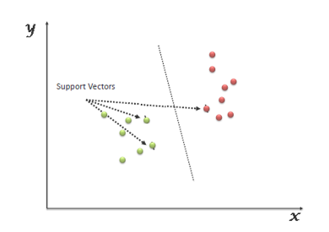
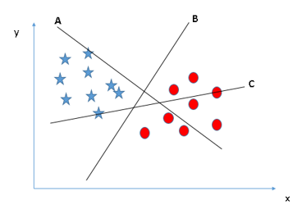
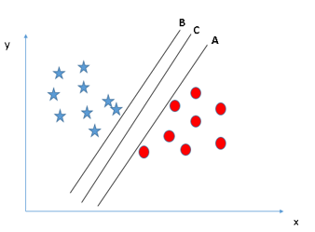
SVM – Support Vector Machine
z
z

Slide 10
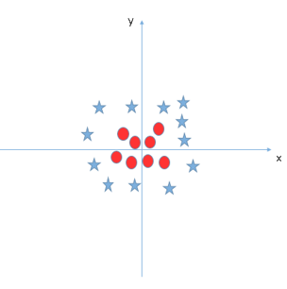
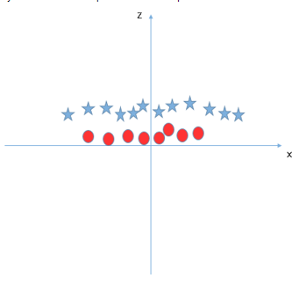
What if we have such data – Kernel trick
z=x^2+y^2

Slide 11
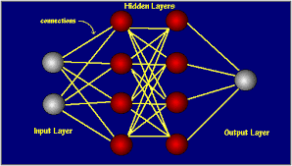
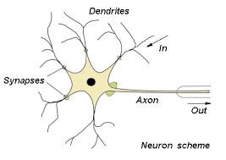
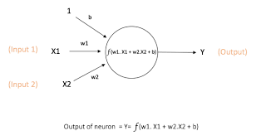
Neural Network
z
Inspired by human biological neural networks in the human brain process information.
The basic unit of computation in a neural network is the neuron, often called a node or unit.

Slide 12
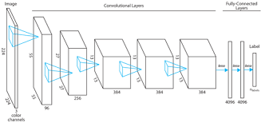
Alexnet
Pretrained Convolutional Neural Network
650K neurons
60M parameters
630M connections

Slide 13
Used data augmentation techniques that consisted of image translations, horizontal reflections, and patch extractions.
Implemented dropout layers in order to combat the problem of overfitting to the training data.
Trained the network on ImageNet data,
15 million annotated images
Over 22,000 categories.

Slide 14
Integrating All -
Data Acquisition.
Feature Extraction using Alexnet using neural network toolbox for alexnet in MATLAB.
Dataset –
Training Data
Testing Data
Trained the SVM classifier with the extracted features
Testing the classifier.

Slide 15
Code
Download Alexnet and Neural Network Toolbox
Loading the data and dividing it.
images = imageDatastore('mydata',... 'IncludeSubfolders',true,... 'LabelSource','foldernames'); [trainingImages,testImages] = splitEachLabel(images,0.7,'randomized');
net.Layers

Slide 16
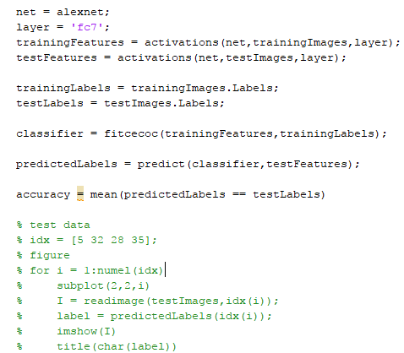
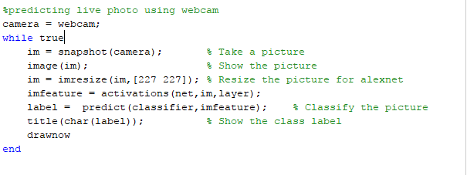

Slide 17
Future Aspects -
Improving the accuracy
Lessen the size of dataset
Implement it on FPGA
Make a neural network from scratch !

Slide 18
Thanks Suggestions/Feedbacks Please !
Made By-
Anshu Nainiwal (2015Kuec2009)
Ayushi Jain (2015kuec2011)

